Slide 1
Classification With Neural Networks Using Python
SAMIYA SADIQ
samiyasadiq2002@gmail.com

Slide 2
agenda
What is Classification
Neural Networks
Classification with Neural Networks

Slide 3
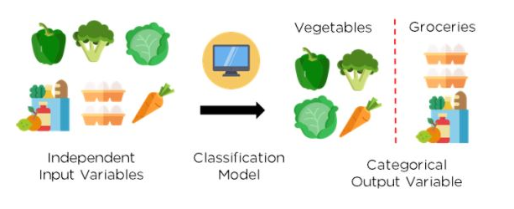
What is Classification?
Classification is a type of supervised machine learning algorithm and is described as the process of recognizing, comprehending, and categorizing things and thoughts into predefined groups, also known as "subpopulations." Classification in machine learning systems uses a broad range of methods to classify future datasets into suitable and relevant categories with the help of these pre-categorized training datasets. Classification algorithm is used in Speech Recognition, Detecting spam E-mails, etc.

Slide 4
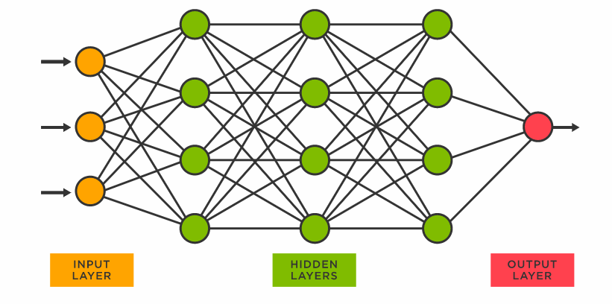
Neural Networks
Artificial neural networks (ANN), more commonly referred to as neural networks (NN), are computing systems inspired by the biological neural networks that constitute human brains. Artificial neural networks (ANNs) consist of node layers, containing an input layer, one or more hidden layers, and an output layer. Each node, or artificial neuron, connects to another and has an associated weight and threshold. If the output of any individual node is above the specified threshold value, that node is activated, sending data to the next layer of the network. Otherwise, no data is passed along to the next layer of the network.

Slide 5
Neural networks are made up of layers of neurons these neurons are the core processing units of the network. First, the input layer is where we feed our inputs, the hidden layer that is responsible for most of the computation and the output layer predicts our output. Neurons of one layer are connected to the neurons of the next layers through channels. Each of these channels is given numeric values known as weights. The inputs are multiplied with the corresponding weights and their sum is sent as input to the neurons in the hidden layer. Each of these neurons is associated with numeric values called the bias which is then added to the input sum. This value is then passed to the threshold function called the activation function. The result of the activation function determines if the particular neuron will get activated or not. An activated neuron transmits data to the neurons of the next layer over the channels. In this manner, the data is propagated through the network. This is called Forward Propagation. In the output layer the neurons with the highest value fire and determine the output (The values are probability). Our network is yet to be trained during this training process along with the input it also has the output fed. The predicted output is compared against the actual output to realise the error in the prediction. The magnitude of the error indicates how wrong we are. The sign suggests if our values are higher or lower than expected. This information is then transferred backwards through our network. This is known as Backpropagation. Now based on this information, the weights are adjusted. This process of forward propagation and backward propagation is iteratively performed with multiple inputs. This process continues until our network has weights such that it can make accurate predictions in most cases. It might take a lot of time to train our neural networks. APPLICATIONS OF NEURAL NETWORK: 1. Facial Recognition 2. Forecasting stock prices or weather 3. Healthcare 4. Signature Verification and Handwritten Analysis

Slide 6
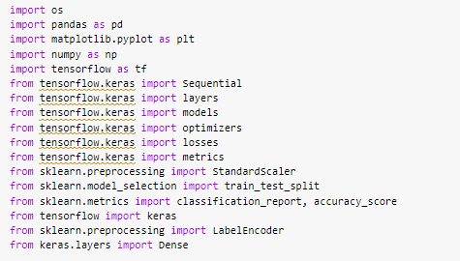
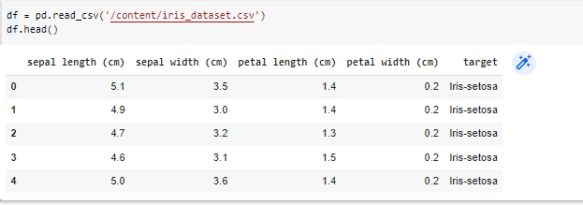
CLASSIFICATION WITH NEURAL NETWORKS
I am using the iris dataset which consists of 5 attributes they are sepal length in cm, sepal width in cm, petal length in cm, petal width in cm and target for classification with neural networks.
1. Import the relevant modules or libraries
2. Read your dataset

Slide 7
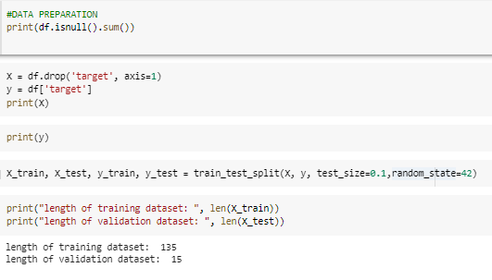
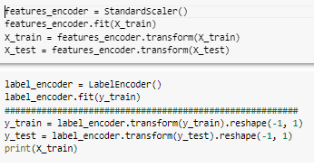
3. DATA PREPARATION:
Here, I will check if our dataset consists of null values. Upon checking I found that there are no null values. Then I separate ‘target’ and inputs by having variables x and y assigned to each of them. Finally spilt it into training and testing (our test_size is “0.1”)
4. Standardization or mean removal and variance scaling is a common requirement for many machine learning estimators implemented in scikit-learn. Here width and the length of sepal and petal are in centimetres therefore they are required to be normalized. So, we use StandardScaler() on X_train and X_test and use LabelEncoder() on y_train and y_test (NOTE: label encoder can be used to transform non-numerical labels to numerical labels)

Slide 8
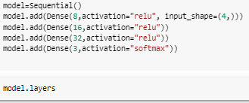

4. Now I will be creating the model using Keras.Sequential. We define and construct the architecture of the model. We are using Dense layers to define the input, output and intermediate layers. A sequential model is appropriate for the plain stack of layers. We have used relu (Rectifier Linear Unit) which is one of the most popular activation functions used in the hidden layer of Neural Networks Its primary benefit is that it avoids and corrects the vanishing gradient problem while being less computationally expensive than tanh and sigmoid. We have also used softmax, which is mostly used in the last layer NN which calculates the probabilities distribution. Its main advantage is it can handle multiple classes.
5. Once I have specified my model, I will have all the layers inside my model then we will compile our model. To compile the model we require three arguments: Optimizer - It could be a string identifier of an existing optimizer or the instance of the optimizer class. Loss -This is the objective that the model will try to minimize. It can be a string identifier to the existing loss function. Metrics – List of all the metrics to be evaluated by the model during training and testing. Can be a string identifier of existing metrics. Typically we use metrics=[‘accuracy’].

Slide 9

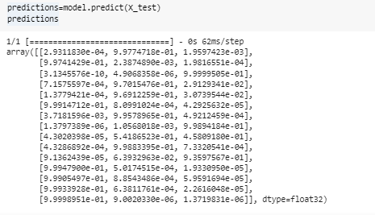
6 Once the model is created and compiled we can train the model with model. fit() or use the model to predict using model .predict(). Here, fit the model using X_train and y_train, epochs indicate how many times we are going through the entire dataset, By setting verbose 0, 1 or 2 we say how you want to “see” the training progress of each epoch. We set verbose as 0 and it will show us nothing. You can set it as 1 or 2 if you want. And in validation_data we can pass dataset instances here we passed X_test and y_test (Step 4).
7. Viewing the summary of the model and then evaluating our data

Slide 10
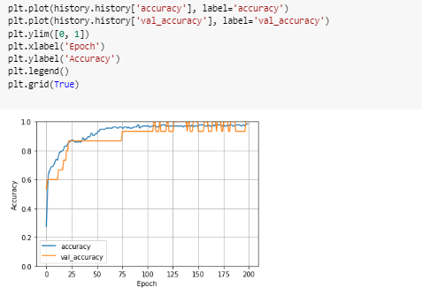
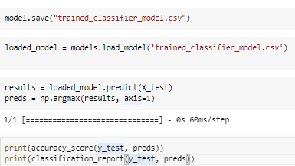
8. Now, Lets plot accuracy l 9. Save and load the model. Then try to make predictions for the loaded model

Slide 11
Thank You
Important Links:
DATASET-LINK
GitHub
Guide to tensorflow_keras
keras Optimizers
Preprocessing data

